Slide 1
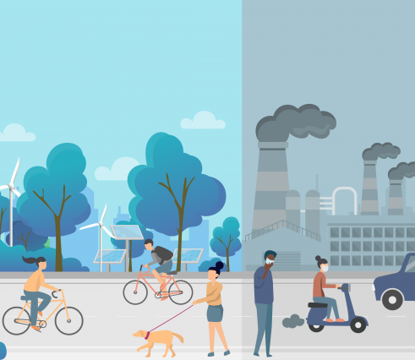
“2024 U.S. Air-Quality Snapshot”
Ali Nizar · CS 445 Stage 3

Slide 2
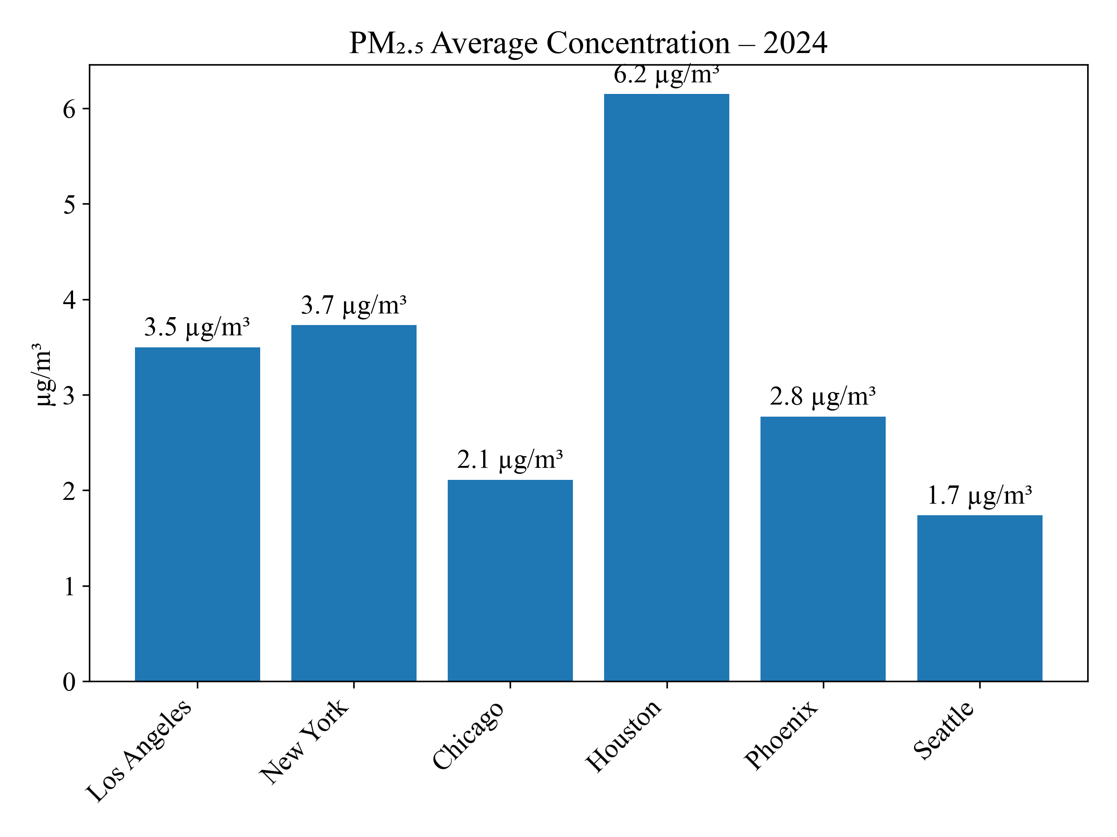
PM\u2082.₅ – Six Major Cities (2024)
Seattle posts the cleanest air at 1.7 µg/m³ while Houston tops the chart at 6.2 µg/m³. Even within a single year, particulate levels vary more than three-fold across major metros.

Slide 3
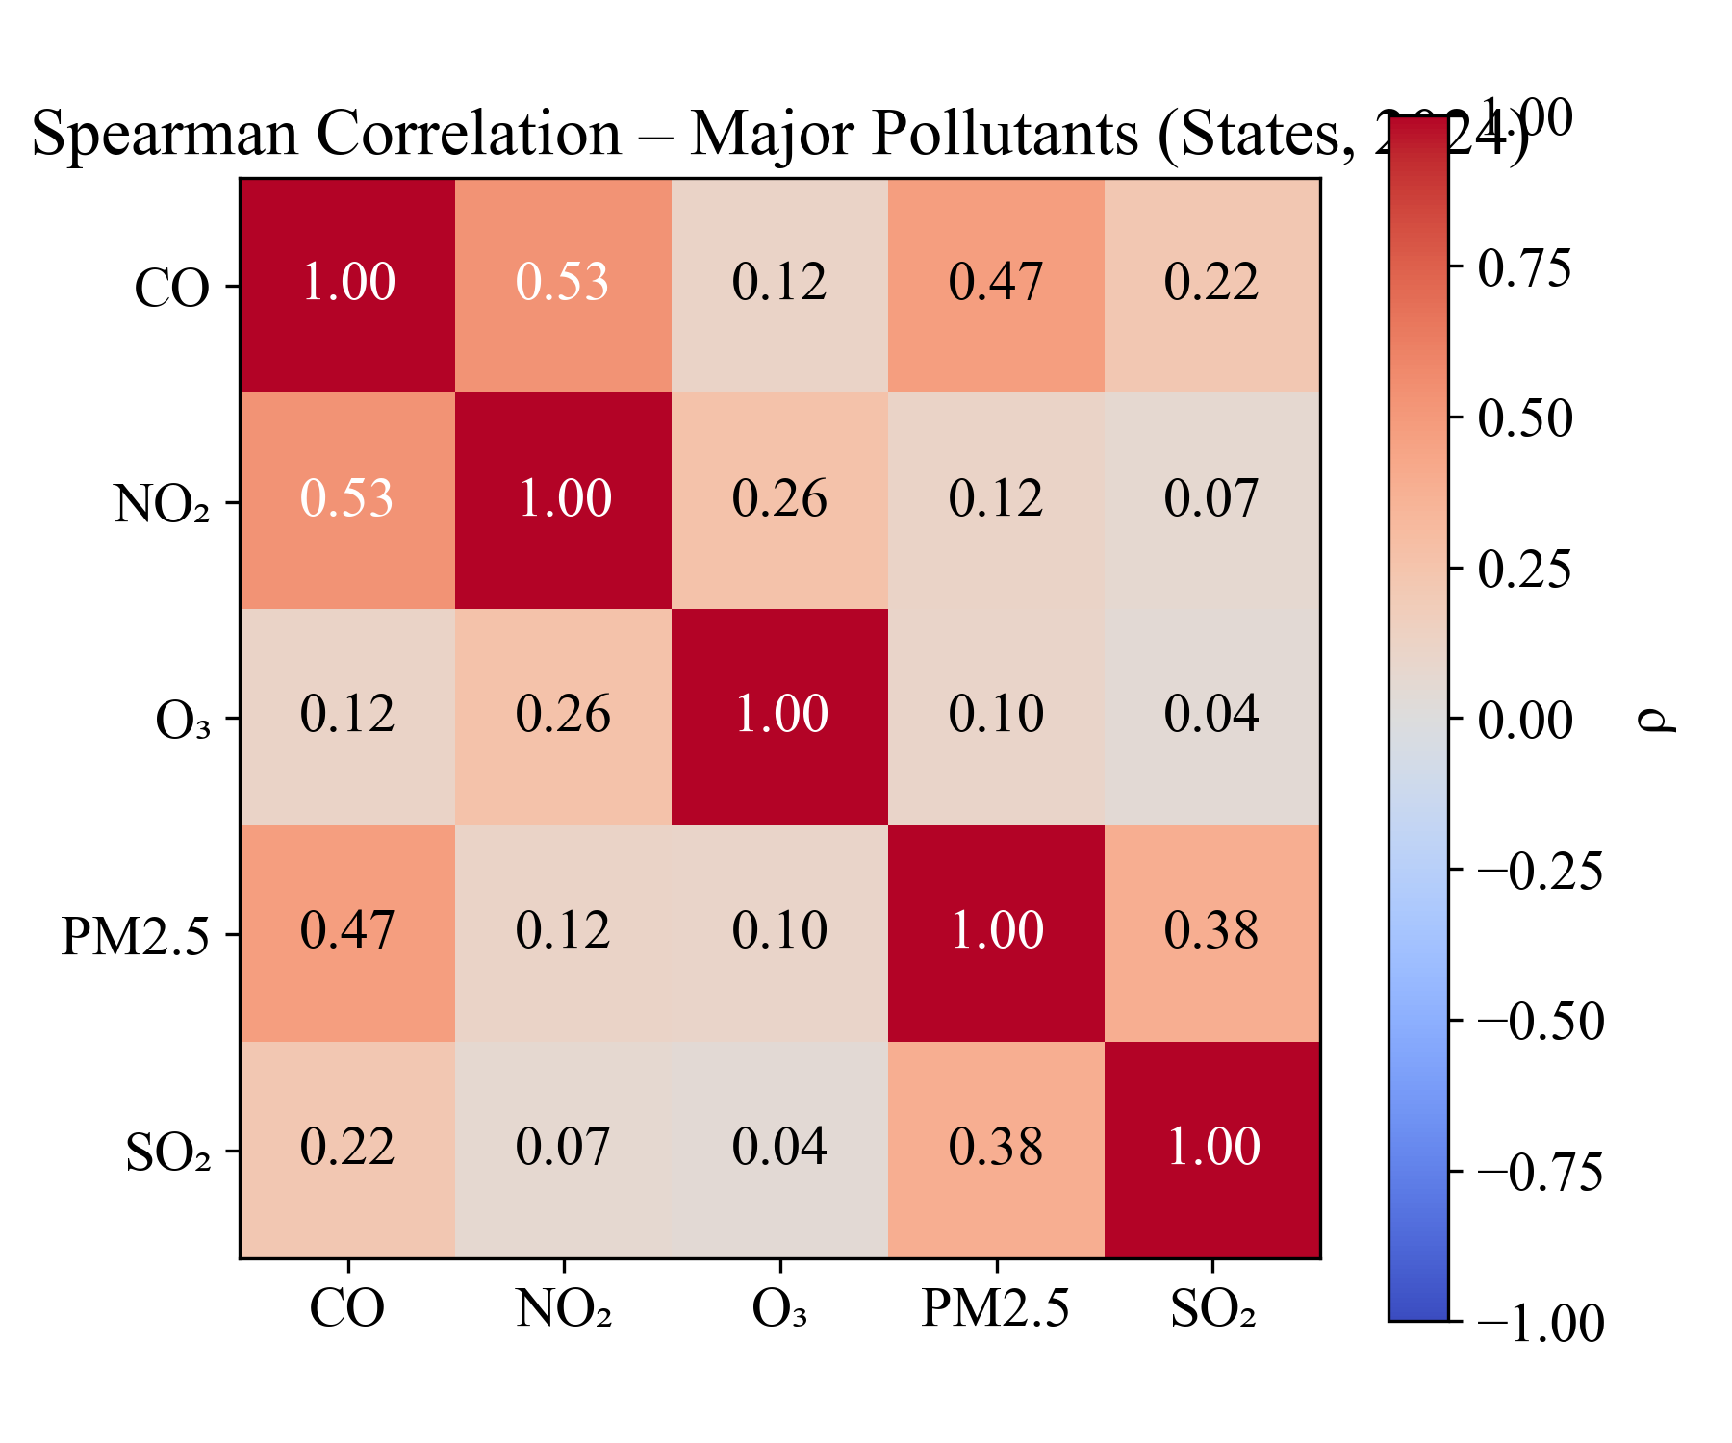
Spearman Correlation – Major Pollutants (States, 2024)
Traffic-related pollutants CO, NO₂, and PM remain strongly linked across states (ρ≈0.5). SO₂ correlates weakly, reflecting its more stationary-source origins."

Slide 4
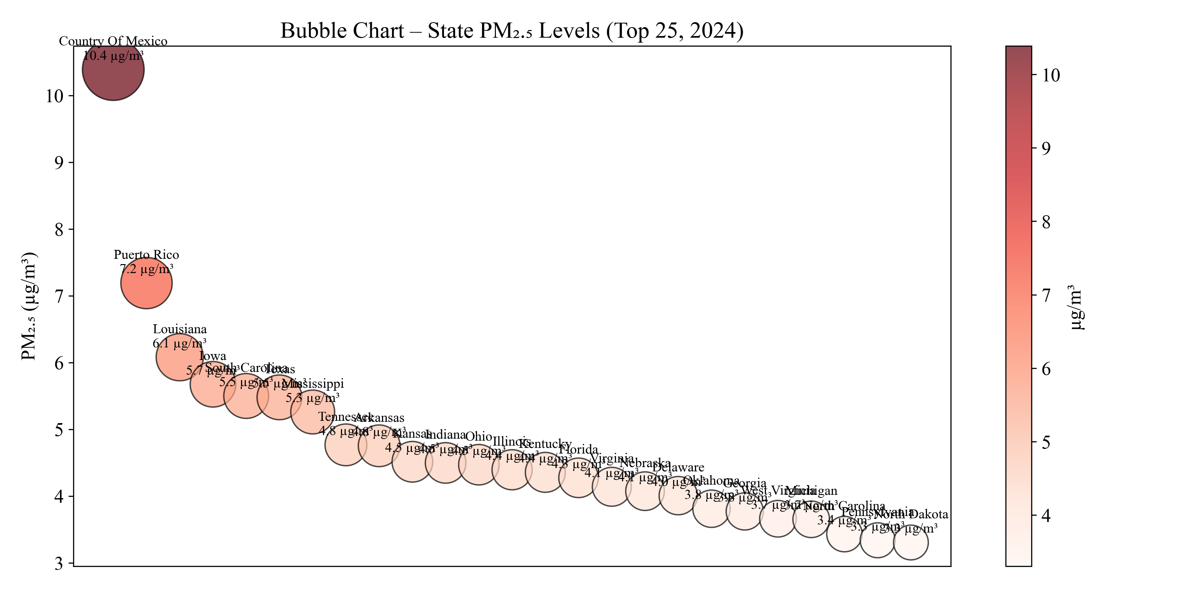
PM\u2082.₅ Hot-Spots – Bubble View (Top 25, 2024)
A handful of jurisdictions—led by “County of Mexico” and Puerto Rico—drive a disproportionate share of PM\u2082.₅ burden; most states cluster below 6 µg/m³.

